Slide 1

Project Proposal ON
Real-Time Chat SYSTEM
Presented By:-
Bishal Shrestha (790310)
Chirayu Shrestha (790311)
Pappu Yadav (790324)
Prashant Ghimire (790328)

Slide 2

INTRODUCTION
Instant communication is essential for personal and professional interactions.
This project focuses on developing a real-time chat system.
Ensures seamless, instant messaging across multiple platforms.
Aims to provide a smooth user experience for all users.

Slide 3

PROBLEM STATEMENT
Users expect fast, secure, and seamless messaging, which many platforms fail to deliver.
There’s a need for a lightweight, real-time chat application that ensures smooth communication, user privacy, and minimal server load.

Slide 4

OBJECTIVES
to create simple , effective , And user-Friendly Chatting System

Slide 5

Key Features
Text Messaging
The project includes a robust text messaging feature for instant communication.
File Sharing
Users will have the capability to easily share files among each other.
Audio Call
An integrated audio calling feature will enhance user interaction.

Slide 6

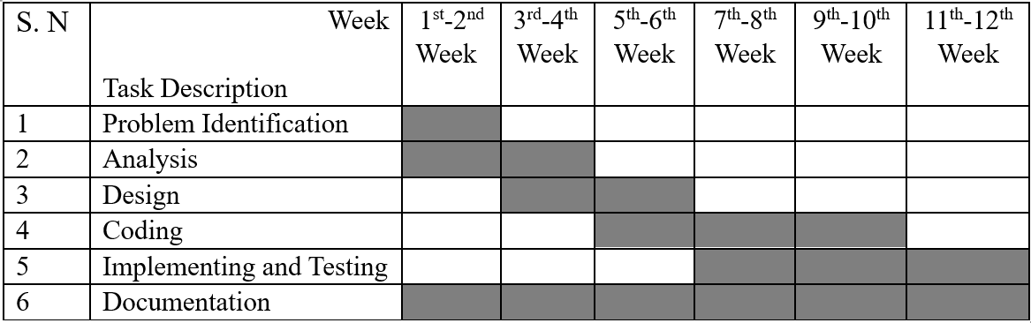
WORK BREAKDOWN

Slide 7

Feasibility Study
Economic Feasibility
The system requires minimal financial investment, using open-source tech and free-tier hosting.
Operational Feasibility
Designed for efficiency on low-spec devices, ensuring wide accessibility for users.
Technical Feasibility
Developed with popular frameworks like Node.js and React, ensuring user-friendly operation.
Schedule Feasibility
Completion estimated in 3 to 4 months, covering all project phases efficiently.

Slide 8
METHODOLOGY
The methodology involves a structured approach to developing the real-time chat system. The algorithm outlines the steps for user authentication, account creation, establishing communication channels, and displaying the chatting page. The flowchart visually represents the process flow, while the use case diagram illustrates the interactions between users and the system. The E-R diagram defines the entities and relationships within the database.
Tools and Platforms: Visual Studio Code

Slide 9
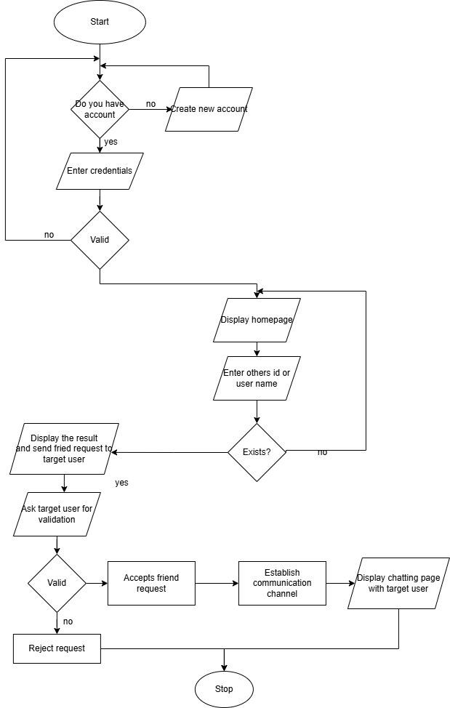
Flowchart

Slide 10
ALGORITM
1. Start
2. Ask the user: "Do you have an account?"
- If No, go to step 3.
- If Yes, go to step 4.
3. Create a new account.
- Proceed to step 4.
4. Enter credentials.
5. Check if credentials are valid:
- If No, prompt the user to re-enter credentials (loop back to step 4).
- If Yes, proceed to step 6.
6. Display homepage.
7. Ask the user to enter another user's ID or username.

Slide 11
8. Check if the entered user exists:
- If No, return to step 7.
- If Yes, proceed to step 9.
9. Display the search result and send a friend request to the target user.
10. Ask the target user for validation.
11. Check if the target user accepts the request:
- If No, reject the request and stop.
- If Yes, proceed to step 12.
12. Establish a communication channel.
13. Display the chatting page with the target user.
14. Stop.

Slide 12
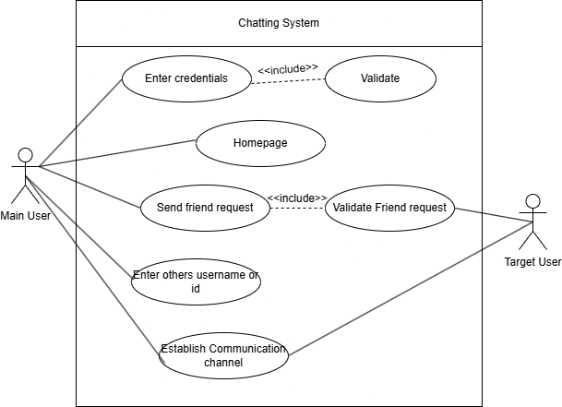
USE CASE DIAGRAM

Slide 13
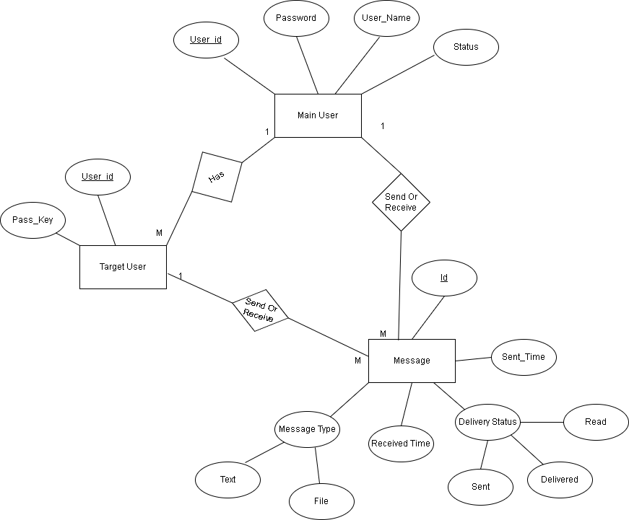
ER DIAGRAM

Slide 14

Thank you!

